Slide 1
CIArb Australia Award Writing Course 12 November 2016
Preparation, Preparation, Preparation!

Slide 2
CIArb Australia Award Writing Course 12 November 2016
BEFORE STAGE 1
Make sure you have a Word document with a style sheet – headings, paragraph, numbers, etc. that works and you can amend
Prepare folders on laptop or hard copies. Start tabbing
Prepare texts for possible jurisdictional challenges.
Print out ToCs
Prepare the award skeleton

Slide 3
CIArb Australia Award Writing Course 12 November 2016
STAGE 1
Start drafting the award, especially the formalities.
Table of Contents
Headings.
Signature
Fill in as much information as possible.
Highlight any portions you may need to update or correct.

Slide 4
CIArb Australia Award Writing Course 12 November 2016
PRE-STAGE 2
Logistics! Makes sure you have:
USB (in case your WiFi malfunctions)
A mouse – if your hand cramps
Water and Food – even a banana?
Pens, Highlighters
A back up copy of the award on your laptop.
A hardcopy of the award

Slide 5
CIArb Australia Award Writing Course 12 November 2016
STAGE 2 – Exam Day
Get everything organized and start with deep breaths
Read thoroughly – don’t highlight everything
Don’t panic if:
There are far more pages than you expected.
There is no jurisdictional issue
There is no law
There is no seat, lex arbitri or substantive law

Slide 6
CIArb Australia Award Writing Course 12 November 2016
STAGE 2 – Exam Day – Writing the Award
Make corrections first
Add new:
Procedural steps (hearing, orders)
Facts to undisputed facts or relevant party
There is no law
There is no seat, lex arbitri or substantive law
Don’t forget to address CISG, if applicable.

Slide 7
CIArb Australia Award Writing Course 12 November 2016
STAGE 2 – Exam Day – Writing the Award
If you need to assume facts or law, explain in a FN
Same for IBA Rules, Guidelines (Evidence or Conflicts)
Incorporate new:
Procedural steps (hearing, orders)
Facts to undisputed facts or relevant party
Give reasons – especially for losing party

Slide 8
CIArb Australia Award Writing Course 12 November 2016
STAGE 2 – Exam Day – Writing the Award
Interest
Pre-award?
Post?
Power – from Parties/Law?
On costs?
From when?
Costs
Costs follow the event. Derogations?
Arbitrator Fees
Institution costs

Slide 9
CIArb Australia Award Writing Course 12 November 2016
STAGE 2 – Exam Day – Writing the Award
Include a conclusion on each finding, and indicate why you prefer a party’s evidence, account of the facts, law, etc.
Use strong language
Give the total of damages if from different categories.
Don’ t forget first paragraph of dispositive section
Or the place where signed

Slide 10
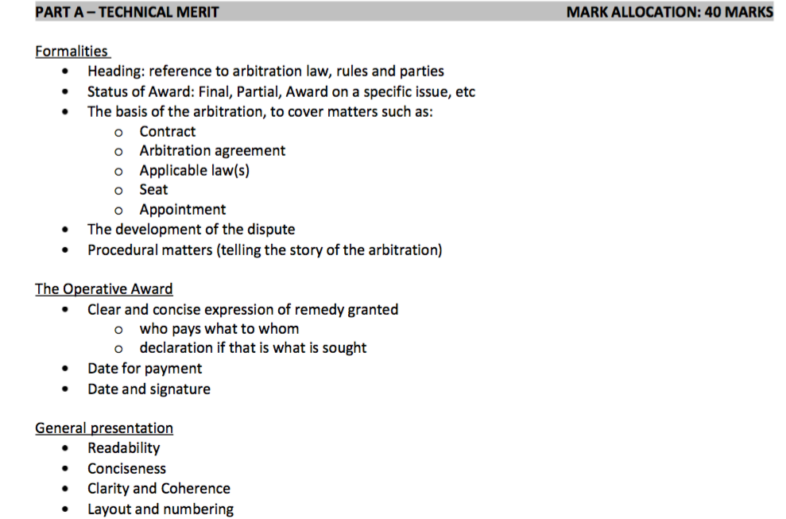
CIArb Australia Award Writing Course 12 November 2016

Slide 11
CIArb Australia Award Writing Course 12 November 2016

Slide 12
CIArb Australia Award Writing Course 12 November 2016
Some Tips and Pointers
Always leave time to reread – set your timer
Do practice awards if you can
Don’t worry about not having proper ‘briefs’ from ‘counsel’
Don’t change your decision at the exam – stick with it and substantiate it

Slide 13
CIArb Australia Award Writing Course 12 November 2016
Good Luck!

