Slide 1
cooperating with the facilitator while protecting client rights
YIMC Seminar, Hong Kong, July 6, 2016

Slide 2
cooperating with the facilitator while protecting client rights
Prepare Your Case
Know the facts and the law
Know your client’s needs and interests
Draft a mediation statement with your client that flags potential
Impasses
Options
Areas of agreement
Know your BATNA
Know the other party’s BATNA
Know your bargaining zone – reservation price and non-financial interests

Slide 3
cooperating with the facilitator while protecting client rights
Prepare Your Client
Manage client expectations through educating about the process
Explain differences with adversarial proceedings
Separate the people from the problem
Work with the other side, not against
Encourage empathy - not incompatible with assertiveness
Fight for interests, not positions
Keep an open mind
Prepare your client to participate actively
Help your client to understand real interests and goals

Slide 4
cooperating with the facilitator while protecting client rights
During the Mediation Session: What to do
Represent your client zealously, not aggressively
Focus on interests, not positions or legal arguments
Listen attentively to the other party
Remain flexible and open to different options
Reality test
Don’t lose sight of your ethical duties
Be open to continuing contact with the mediator if there is no settlement

Slide 5
cooperating with the facilitator while protecting client rights
During the Mediation Session: What to avoid
Acting aggressively
Posturing, excessive puffery
Making insulting offers
Using the mediation as a litigation tool
Wanting to “WIN” at all costs
Trying to settle at all costs

Slide 6
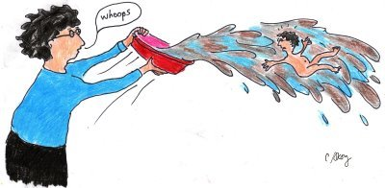
cooperating with the facilitator while protecting client rights
Don’t throw out the baby with the bath water!

Slide 7
cooperating with the facilitator while protecting client rights
Thank you for your attention.

